Slide 1

Human perception
and UI tricks

Slide 2
Human perception
UX != UI

Slide 3
Application
The main criterion of a good application for any user is responsiveness
150 milliseconds

Slide 4
300 milliseconds delay
html { -ms-touch-action: manipulation; touch-action: manipulation; }
VS
JS libraries

Slide 5
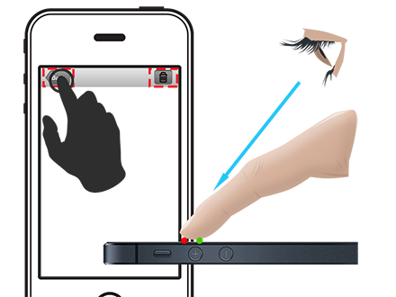
Problem of touching

Slide 6

Problem of touching

Slide 7
Problem of touching
http://cheeaun.com/blog/2012/03/how-i-built-hacker-news-mobile-web-app
http://www.uxmatters.com/mt/archives/2013/03/common-misconceptions-about-touch.php

Slide 8
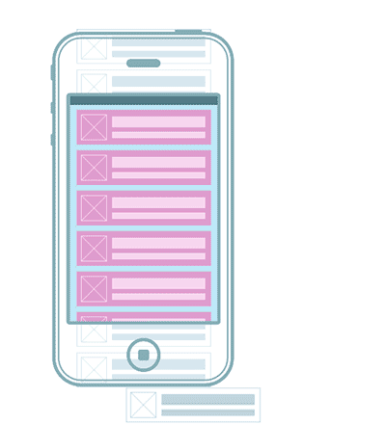
Lightweight

Slide 9
Checklist
100 - 300 - 100
Consider 60 fps.
Keep in mind the 300 ms lag on mobile devices.
Keep in mind the problem of touch: a finger is not the point on the screen. Use the recommended sizes of interface elements.
Become a user: an animation lag gets annoying at several hundred milliseconds.
Use the pattern bundle Flyweight + Object Pool for interfaces with large volumes of same-type object.
Keep in mind: the main criterion of a successful app for endusers - it's when they don't get annoyed.

